Slide 1

 | S.S.V.P.S’s B. S. Deore Polytechnic, Dhule Department of Computer Engineering Academic Year : 2026-2027
SEMINAR AND PROJECT INITIATION COURSE
Sem : CO 5 K |  | SPI – 315003 | Date : 17/10/2026
Topic : AI in Digital Forensics
Roll No. |  | Name of Student
75 |  | Vedika Hemant Patil
87 |  | Trupti Chhotu Shende
94 |  | Kirtika Suresh Sonwane
109 |  | Neha Gangadhar Wagh

Slide 2
Contents
Certificate
Abstract
Introduction
Literature Review
Information to Seminar topic
Advantages and Disadvantages
Conclusion
Project Initiation :
6. 1 Description of problem statement.
6. 2 Scope and objectives.
6. 3 Stake holder
6. 4 Seminar exsicussion plan
6.5 Platform/ Equipment/ Resources identification.
Bibliography
References

Slide 3
Abstract
AI in Digital Forensics uses Artificial Intelligence (AI) and Machine Learning (ML) to assist investigators in examining large volumes of digital evidence from computers, mobile phones, networks and cloud services. Traditional investigations can require significant time to search files, messages, images and logs.
AI can help classify files, detect suspicious patterns, group related evidence and reconstruct event timelines. Research shows promising support for evidence triage and analysis, but AI results must be validated by trained investigators.
The proposed seminar project explores a prototype that analyzes a prepared forensic dataset, flags potentially relevant artifacts and produces a reviewable report while preserving evidence integrity and human oversight.

Slide 4
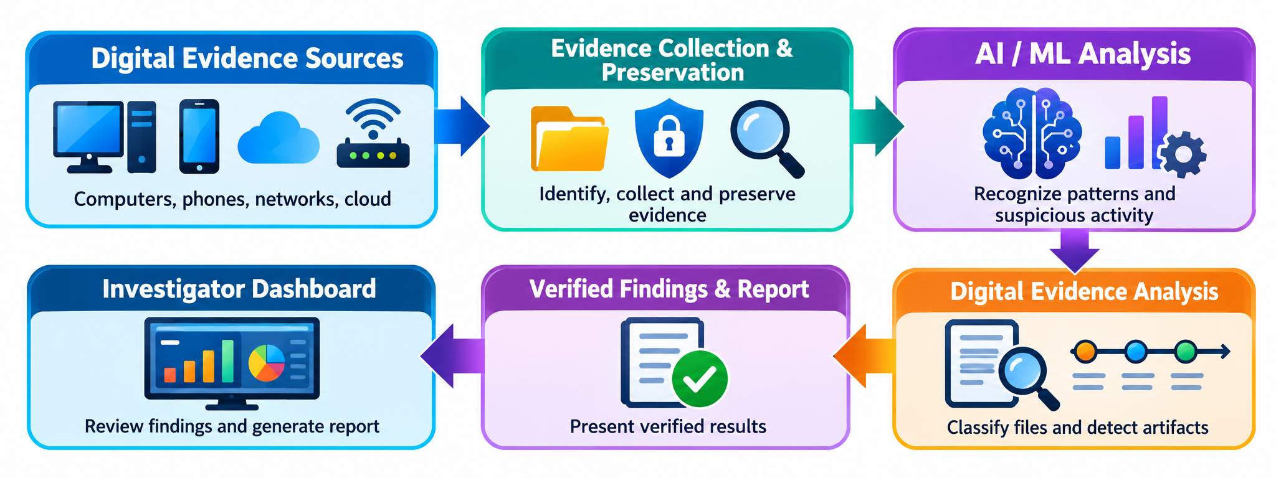
1. Introduction
Digital forensics is the process of identifying, collecting, preserving, examining and presenting digital evidence.
Digital evidence may come from computers, mobile phones, networks, cloud accounts and multimedia files.
Manual examination of large datasets can be slow and difficult.
AI and ML can help prioritize files, recognize patterns and identify suspicious activity.

Slide 5
2. Literature Survey
Sr. No. | Approach Type | Technologies Used | Dataset | Key Objective | Limitations
1 | AI/ML in digital forensics review | Machine learning, pattern recognition, forensic workflow | Literature review | Survey AI use across evidence collection, analysis and incident response | Research maturity varies by task; validation needed.
2 | AI in mobile forensics survey | AI/ML, mobile-device artifacts | Literature review | Review current AI uses and mobile forensic scenarios | Models may not generalize to real-world data.
3 | AI-assisted evidence triage | Classification, ranking, keyword/rule matching | Prepared forensic files | Prioritize artifacts for human examination | False positives and missed evidence are possible.

Slide 6
Sr. No. | Approach Type | Technologies Used | Dataset | Key Objective | Limitations
4 | Timeline reconstruction support | Log parsing, event correlation, ML | System and application logs | Connect events and help build investigation timelines | Incomplete timestamps and noisy logs affect results.
5 | Multimedia forensic analysis | Computer vision, image/audio classification | Image, audio and video samples | Group media and flag suspicious or manipulated content | Performance depends on data quality and model bias.
6 | Malware and file classification | Static features, ML classifiers, file hashes | Known benign/malicious samples | Identify files needing closer examination | New or obfuscated malware can evade detection.

Slide 7
Sr. No. | Approach Type | Technologies Used | Dataset | Key Objective | Limitations
7 | Network incident forensics | Log analysis, anomaly detection, ML | Network-flow and security logs | Find unusual traffic and correlate events | Encrypted traffic and false alerts limit analysis.
8 | Evidence integrity and handling | SHA-256 hashing, audit logs, chain of custody | Forensic images and evidence records | Check integrity and document evidence handling | AI does not replace established evidence procedures.
9 | Automated artifact extraction | Forensic parsers, Python, databases | Disk/mobile forensic artifacts | Extract structured records for review | Tool support varies by device and file system.

Slide 8
Sr. No. | Approach Type | Technologies Used | Dataset | Key Objective | Limitations
10 | Forensic tool testing | Repeatable test sets, validation procedures | Known/reference datasets | Assess tool behavior and reproducibility | Testing one scenario does not prove universal reliability.
11 | AI-supported reporting | Summarization, structured reports, analyst review | Verified investigation findings | Make results easier to review and communicate | Generated text must be checked against source evidence.

Slide 9
3. Information to seminar topic
Technology: Artificial Intelligence (AI), Machine Learning (ML) and Digital Forensics
Main Purpose: To assist investigators in finding relevant digital evidence efficiently.
Key Concept: AI analyzes patterns in files, logs, messages and multimedia data.
Approach: Collect forensic images/logs safely, extract artifacts, analyze copies using rules and ML, then verify findings.
Main Benefit: Faster evidence triage and better prioritization of suspicious artifacts.
Application: Cybercrime investigations, incident response, mobile/device forensics and fraud analysis.

Slide 10
4. Advantages / Disadvantages
Advantages
Speeds up searching and sorting large volumes of digital evidence.
Helps identify unusual patterns, suspicious files and related artifacts.
Can support timeline reconstruction and evidence prioritization.
Reduces repetitive manual work for investigators.
Can assist analysis of text, images, logs and network events.
Disadvantages
AI may produce false positives or miss relevant evidence.
Results can be biased if training data is incomplete.
Some models are difficult to explain or reproduce.
Sensitive evidence requires strong privacy and access controls.
AI findings alone may not be sufficient for legal conclusions.

Slide 11
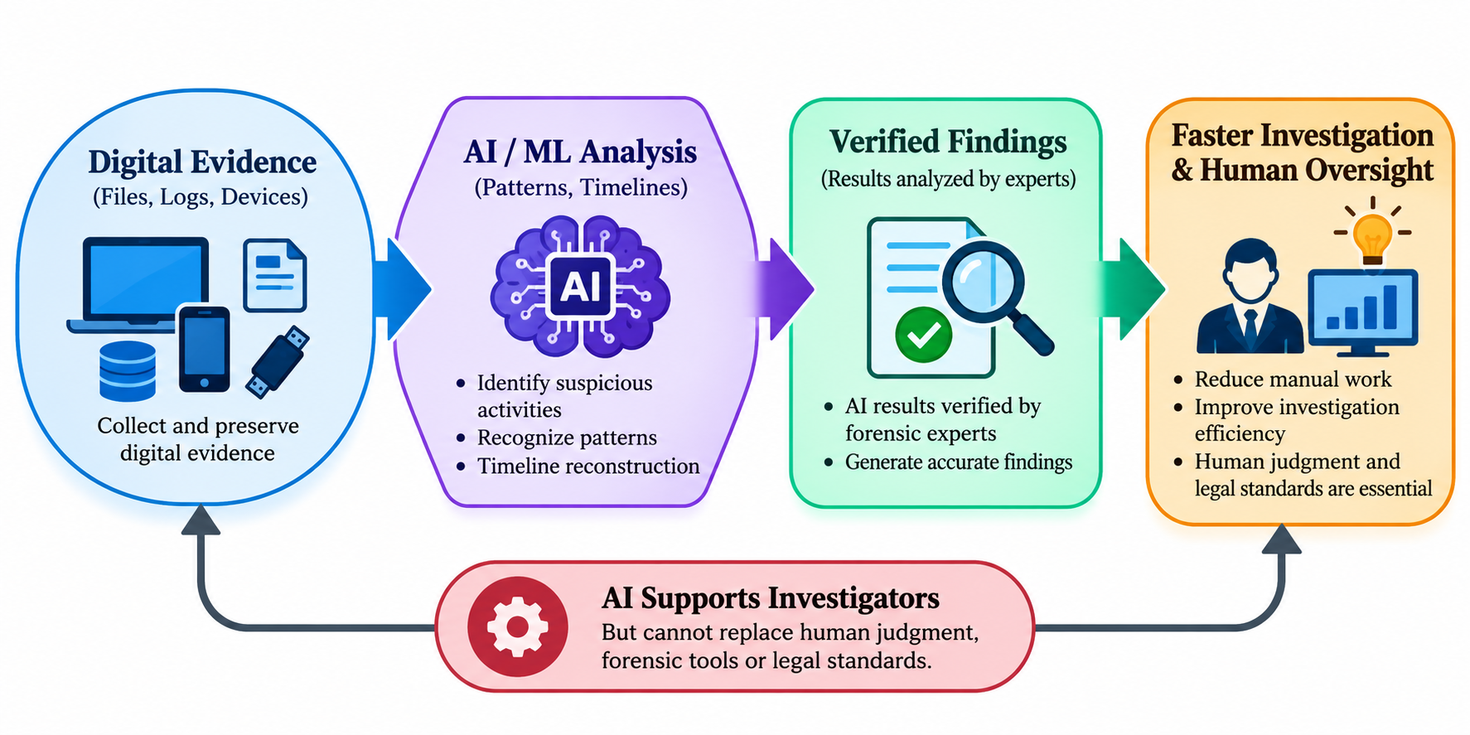
5. Conclusion
AI helps digital forensic investigators analyze large amounts of digital evidence quickly and identify suspicious activities. It also supports pattern recognition, timeline reconstruction and incident response. However, evidence must be preserved properly, and AI results must be verified by experts. AI can reduce manual work and improve investigation efficiency. Therefore, AI supports investigators but cannot replace human judgment, forensic tools or legal standards.

Slide 12
6. Project Initiation
The AI in Digital Forensics seminar was initiated to explore how intelligent techniques can support investigations involving computers, mobile devices and other digital sources.
The proposed project focuses on analyzing a controlled sample dataset, extracting useful artifacts, identifying suspicious patterns with AI/ML assistance and presenting findings in a simple report.
The design emphasizes evidence integrity, transparent results and human verification.

Slide 13
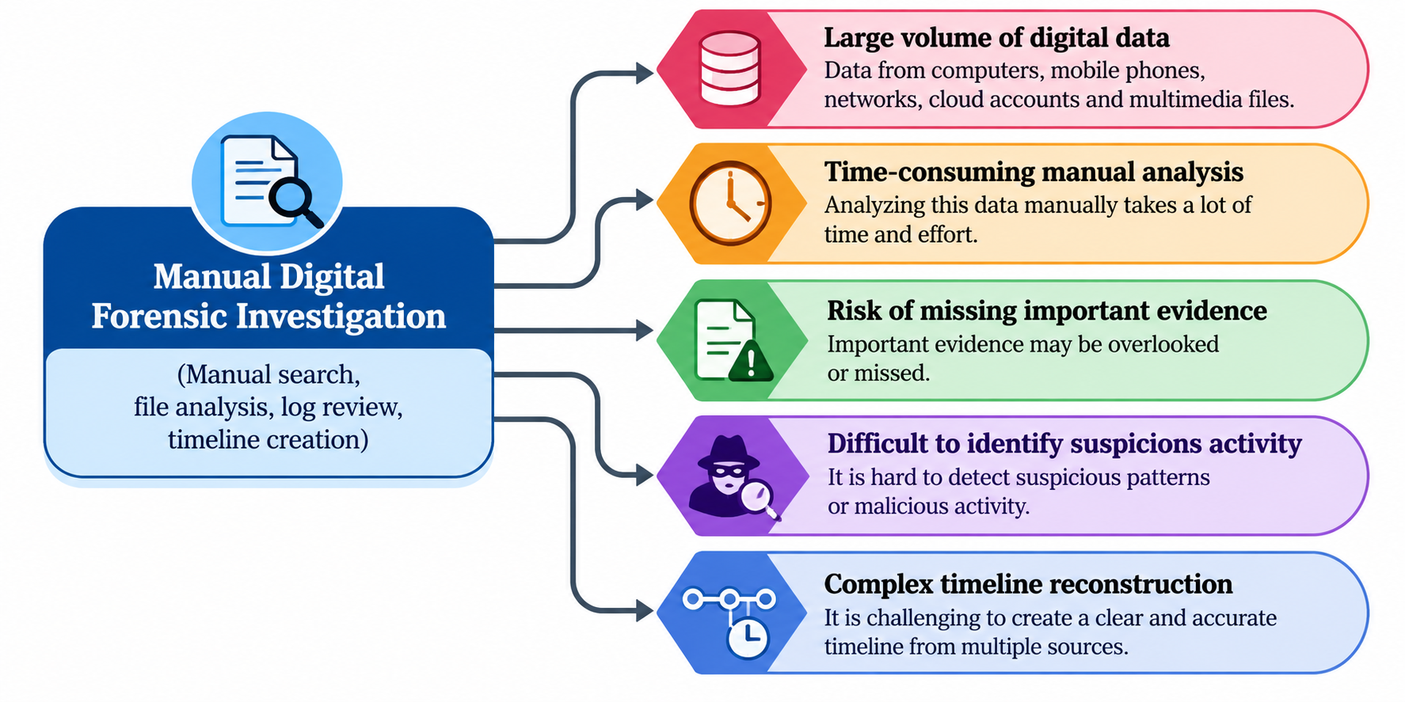
6.1 Description of Problem Statement
Digital investigations generate large amounts of data from computers, mobile phones, networks, cloud accounts and multimedia files. Analyzing this data manually is time-consuming, complex and prone to human error. Important evidence may be missed, and it is difficult to identify suspicious activity or create a clear timeline. Therefore, there is a need for an AI-based system to automatically analyze and prioritize digital evidence to support investigators.

Slide 14
6. 2 Scope and objectives
Objectives
Understand the digital forensic evidence lifecycle.
Load a prepared sample dataset or forensic artifacts for analysis.
Use Python-based rules and ML/NLP techniques to categorize or prioritize artifacts.
Flag potentially suspicious patterns for investigator review.
Generate a report containing findings, timestamps and confidence/limitations.
Scope
Educational prototype using lawful, synthetic or publicly available sample data.
Focus on evidence triage and analysis—not autonomous accusations.
Possible tools: Python, pandas, scikit-learn, SQLite, Autopsy and hashing utilities.
Results require human verification; the prototype is not a certified forensic tool.

Slide 15
6. 3 Stake holder
Digital Forensic Investigator: Defines the investigation and validates findings.
Cybersecurity / Incident Response Team: Uses findings to understand suspicious activity.
Law Enforcement and Legal Professionals: May review evidence and reports under applicable procedures.
Organization / Evidence Owner: Authorizes access and protects sensitive data.
Project Developers and Guide: Build, test and document the prototype.
Researchers and Students: Study AI methods, limitations and responsible evidence handling.

Slide 16
6. 4 Seminar exsicussion plan
Current Scenario: Digital evidence is collected from computers, mobiles, networks and cloud services.
Investigation Challenges: Large data, deleted files, different formats and limited time.
Existing Approaches: Forensic tools, keyword searches, file hashes and manual analysis.
Research Gap: AI can help analyze evidence, but accuracy and reliability are important.
Proposed System: A Python-based system to identify important evidence and generate reports.
Evaluation: Test the system using sample cases and check errors.
Future Work: Add more evidence types and improve AI accuracy.

Slide 17
6.5 Platform/ Equipment/ Resources
Hardware: Computers, laptops, mobile devices and storage devices are required to collect and examine digital evidence.
Software Tools: Digital forensic tools such as Autopsy, FTK and EnCase are used to analyze and recover digital evidence.
AI / ML Platforms: Python, TensorFlow and Scikit-learn help in pattern recognition, data classification and suspicious activity detection.
Data Storage: Hard disks, SSDs and secure cloud storage are used to preserve digital evidence safely.
Operating System: Windows and Linux provide platforms for running forensic tools and analyzing digital data.
Network Resources: Network monitoring tools help investigate network traffic and identify suspicious activities.
Security Resources: Encryption, access control and hashing techniques help maintain evidence integrity and security.
Human Resources: Digital forensic investigators and AI experts verify results and ensure accurate investigation.

Slide 18
Bibliography
Books
Eoghan Casey, Digital Evidence and Computer Crime, 3rd edition, Academic Press, 2011.
Brian Carrier, File System Forensic Analysis, Addison-Wesley, 2005.
John Sammons, The Basics of Digital Forensics, 2nd Edition, Syngress, 2014.
Ali Dehghantanha et al., Artificial Intelligence in Digital Forensics: Research and Applications.
Websites
NIST Digital Forensics — nist.gov/itl/ai/digital-forensics
NIST Computer Forensic Tool Testing — nist.gov
Autopsy Digital Forensics Platform — autopsy.com
The Sleuth Kit — sleuthkit.org
Python Documentation — docs.python.org

Slide 19
References
Research Papers
Digital Forensics AI: Evaluating, Standardizing and Optimizing Digital Evidence Mining Techniques
Digital Forensics and Strong AI: A Structured Literature Review
Artificial Intelligence in Mobile Forensics: A Survey of Current Status, a Use Case Analysis and AI Alignment Objectives
The Invisible Evidence: Digital Forensics as Key to Solving Crimes in the Digital Age
Machine-Learning Forensics: State of the Art in the Use of Machine-Learning
Techniques for Digital Forensic Investigations within Smart Environments
Large Language Models in Digital Forensics: Capabilities, Challenges and Future Directions
AI-Enhanced Digital Forensics: A Research Vision for Trustworthy, Explainable, and Humancentered Forensic Intelligence

Slide 20
Thank you

